Slide 1
Analyzing the Impact of COVID-19 on Global Population Dynamics
Team Members:
Names
Siddhartha Alwala
Vishnu Priya Palagiri
Shiva Sai Kumar Tummala
Bhargavi Kondaveeti

Slide 2
Introduction
Our project focuses on visualizing the impact of COVID-19 on global population dynamics, aiming to provide insights into how the pandemic has affected different regions and demographic groups.
Through dynamic and interactive visualizations, we aim to uncover patterns, trends, and correlations within the data, facilitating informed decision-making and effective response strategies.

Slide 3
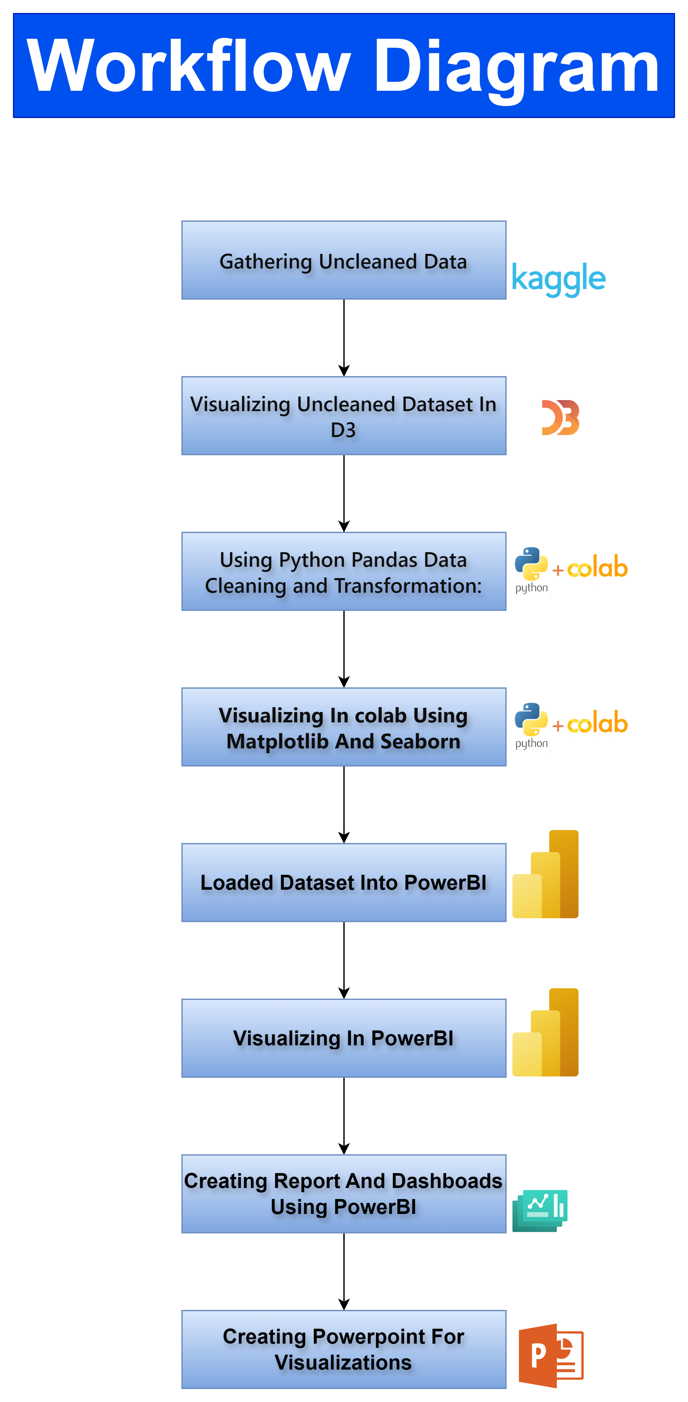

Slide 4
Above Workflow Explanation
Data Collection:
Getting relevant datasets from Kaggle, a popular platform for data science datasets.
Initial Visualization:
Utilizing D3.js to visualize the uncleaned dataset, providing an initial overview of the data's structure and potential insights.
Data Cleaning:
Using Python programming language and libraries like Pandas and NumPy to clean the dataset, handling missing values, outliers, and inconsistencies.
Refined Visualization:
Using Python's data visualization libraries such as Matplotlib or Seaborn to create more refined visualizations based on the cleaned dataset, focusing on specific variables of interest.
Dashboard Creation:
Utilizing Microsoft Power BI to design interactive dashboards and reports, incorporating the refined visualizations to provide a comprehensive view of the analyzed data.
Report Generation:
Creating detailed reports summarizing the analysis findings, insights, and conclusions drawn from the visualizations and data analysis process.

Slide 5
Data Abstraction-Dataset (Type and Attributes)
COVID-19 Dataset:
Type: csv
Attributes:
Date: Date of the record
Country/Region: Name of the country or region
Confirmed Cases: Number of confirmed COVID-19 cases
Deaths: Number of deaths due to COVID-19
Recoveries: Number of recovered COVID-19 cases, etc..
Life expectancy Dataset:
Type: csv
Attributes:
Country/Region: Name of the country or region
Population Size: Total population of the country or region
Life Expectancy: Average life expectancy in years
Development Status: Development status of the country or region (e.g., developed, developing)
GDP (Gross Domestic Product): Economic output of the country or region
And more etc…

Slide 6
Data Abstraction-Detailed Description of Dataset:
The COVID-19 dataset contains weekly records of COVID-19 cases reported by country or region. Each record includes information on confirmed cases, deaths, and recoveries, allowing for the analysis of the pandemic's impact over time and across different regions.
The global population dataset provides demographic information for each country or region, including population size, life expectancy, and development status. This dataset offers insights into the population dynamics of different regions and their susceptibility to the pandemic.
The economic indicators includes GDP values for each country or region, enabling the analysis of the economic impact of the pandemic. GDP serves as a measure of economic output and can help assess the extent of economic disruption caused by COVID-19.

Slide 7
Data transformation tasks involve:
Cleaning and preprocessing the datasets to ensure consistency and accuracy.
Handling missing values, standardizing column names, and converting data types as necessary.
Aggregating and merging relevant information from multiple sources for analysis.
Ensuring data quality through validation checks and addressing any discrepancies or inconsistencies.
Normalizing or scaling attributes if required for certain analyses.
Performing feature engineering to create additional features if needed for enhanced analysis.

Slide 8
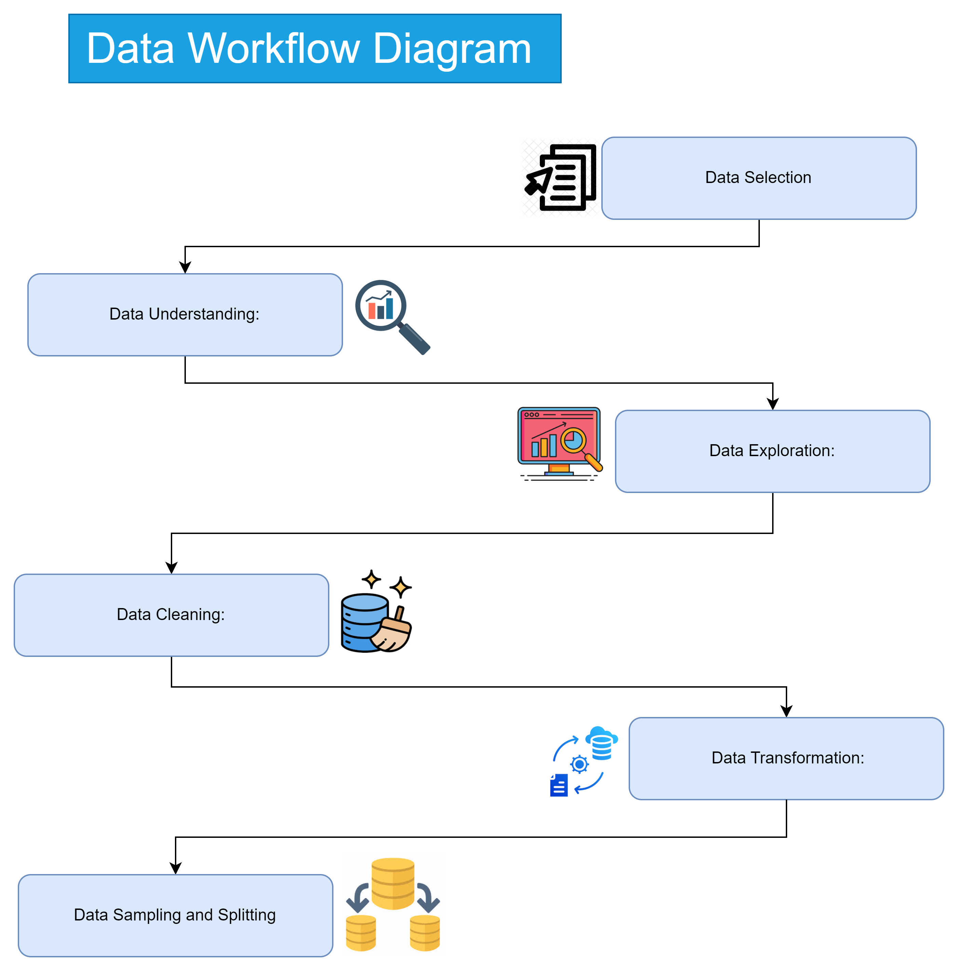

Slide 9
Task Abstraction
Task:
Target: The primary objective is to analyze the impact of COVID-19 on global population dynamics, focusing on key metrics such as confirmed cases, deaths, and recoveries.
Actions:
Analyze trends and patterns in COVID-19 cases across different regions and countries.
Explore correlations between COVID-19 metrics and demographic factors such as population size, life expectancy, and development status.
Investigate the economic implications of the pandemic by examining the relationship between COVID-19 cases and GDP.
Compare average life expectancy and GDP across WHO regions to identify disparities and inform targeted interventions.

Slide 10
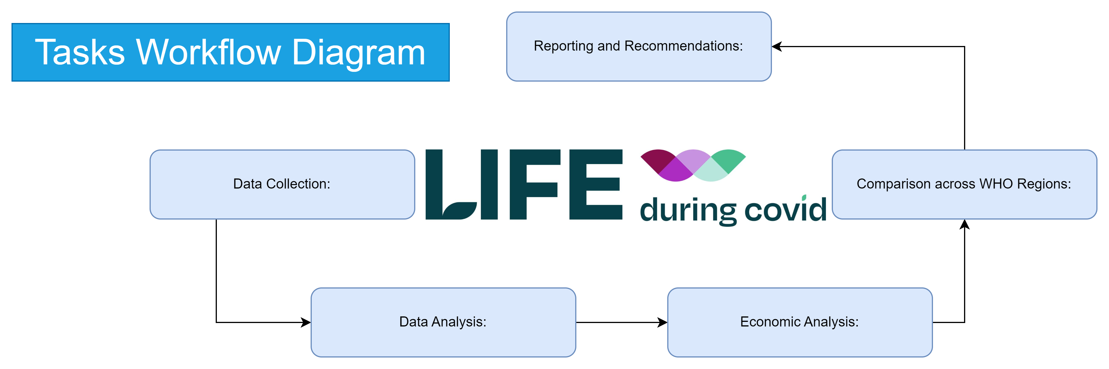

Slide 11
Above Workflow Explanation
Data Collection:
Gather COVID-19 data from reliable sources like WHO or national health agencies.
Collect demographic data from reputable sources like the World Bank or United Nations.
Data Analysis:
Analyze COVID-19 trends globally and regionally to identify patterns.
Conduct correlation analysis between COVID-19 metrics and demographic factors.
Use statistical methods to explore the relationship between COVID-19 cases and GDP.
Economic Analysis:
Investigate the impact of COVID-19 on GDP by analyzing economic data.
Explore how COVID-19 cases have affected different sectors of the economy.
Consider the long-term economic implications of the pandemic.
Comparison across WHO Regions:
Compare average life expectancy and GDP across different WHO regions.
Identify disparities and variations in population dynamics and economic development.
Use these comparisons to inform targeted interventions and policy decisions.
Reporting and Recommendations:
Interpret the findings from the analysis.
Provide recommendations for policymakers and stakeholders based on the insights gained.
Summarize the key points and implications for future action.

Slide 12
Implementation using Tools:
D3.js:
Description: D3.js (Data-Driven Documents) was utilized for the initial visualization of the uncleaned dataset. It provided a platform for creating dynamic and interactive charts and graphs directly within web browsers.
Usage: Through D3.js, we generated interactive visualizations such as bar charts to explore the structure and patterns within the raw dataset.
Python:
Description: Python, along with libraries like Pandas, NumPy, Matplotlib, and Seaborn, played a crucial role in data preprocessing, analysis, and visualization.
Usage: Pandas and NumPy were employed for data cleaning tasks, including handling missing values, outliers, and inconsistencies. Matplotlib and Seaborn were used to create refined visualizations based on the cleaned dataset, showcasing insights through various types of charts and plots.
Microsoft Power BI:
Description: Microsoft Power BI served as a comprehensive platform for designing interactive dashboards and reports, integrating visualizations to provide a comprehensive view of the analyzed data.
Usage: Power BI enabled us to create interactive visualizations, including bar charts, line graphs, and maps, and seamlessly integrate them into interactive dashboards. Additionally, Power BI's data modeling capabilities allowed for the creation of relationships between different datasets, enhancing the depth of analysis in the final reports.

Slide 13

Results for Analysis-Demonstration

Slide 14
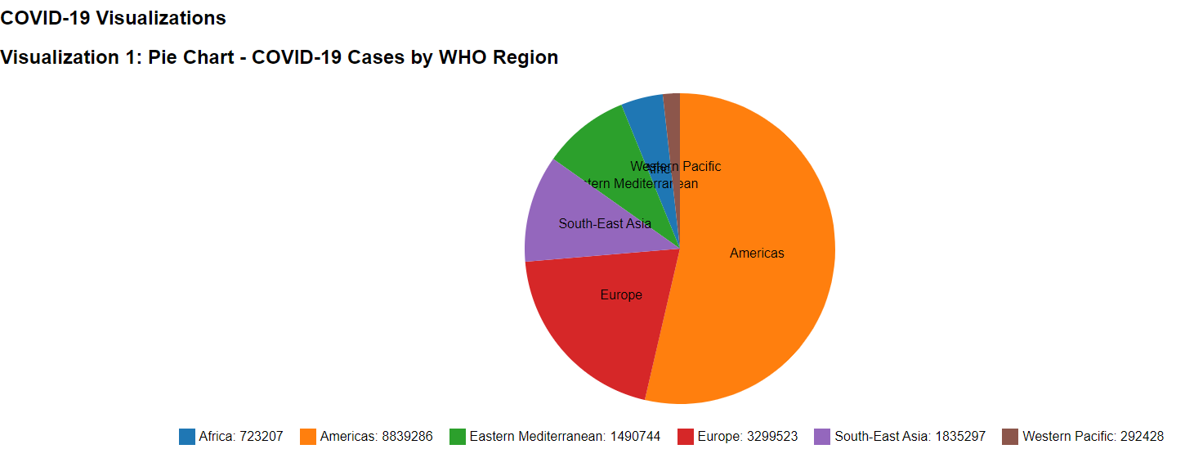
Initial Visualization Using D3.js Pie Chart of COVID-19 Cases by WHO Region(pre-cleaning)
Explanation:
The pie chart provides a clear overview of how COVID-19 cases are distributed among different WHO regions.
We can see at a glance which regions have the highest number of confirmed cases, enabling policymakers and health organizations to allocate resources effectively.
Regions with larger segments may require more attention in terms of healthcare infrastructure and preventive measures.
Story:
Imagine global health officials convening to discuss strategies for combating the spread of COVID-19. As they gather around a screen displaying the pie chart, they immediately notice the significant portion representing the European region, indicating a high number of confirmed cases.
This prompts discussions on implementing stricter containment measures and increasing healthcare capacity in Europe.
Similarly, the smaller segments representing regions with fewer cases spark conversations about sharing resources and best practices to prevent further outbreaks.

Slide 15
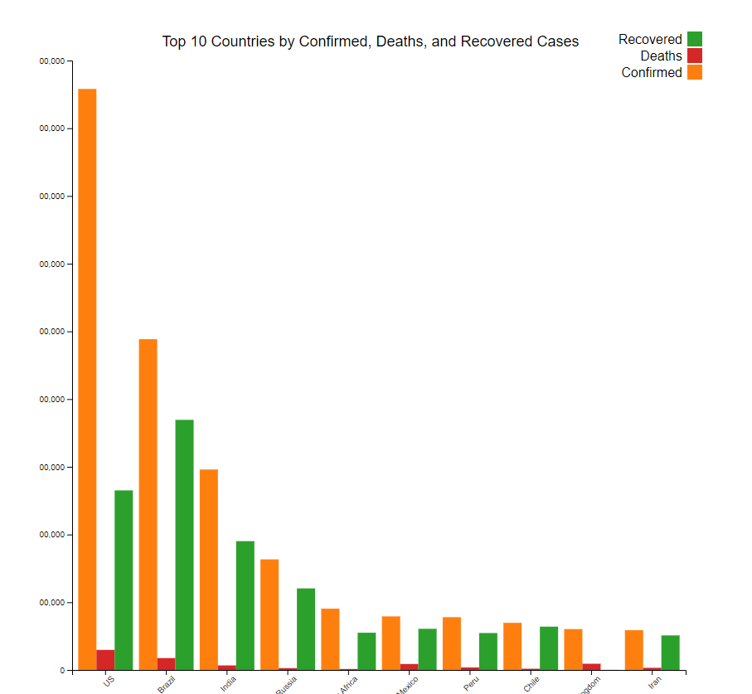
Stacked Bar Chart of COVID-19 Cases by Country-Using D3.js
Explanation:
The stacked bar chart allows for a detailed examination of COVID-19 cases within individual countries. By breaking down each bar into segments for confirmed, deaths, and recovered cases, viewers can see not only the total number of cases but also the outcomes of those cases. This provides insights into how countries are managing the pandemic, including their healthcare systems' capacity to treat patients and mitigate fatalities.
Story:
As policymakers analyze the stacked bar chart, they focus on the disparities in outcomes among the top 10 countries with the highest confirmed cases. They notice that while some countries have a high number of confirmed cases, they've also managed to achieve a substantial number of recoveries, indicating effective healthcare interventions. Conversely, countries with a high proportion of deaths prompt discussions on implementing measures to reduce mortality rates, such as improving access to critical care facilities and vaccine distribution.

Slide 16
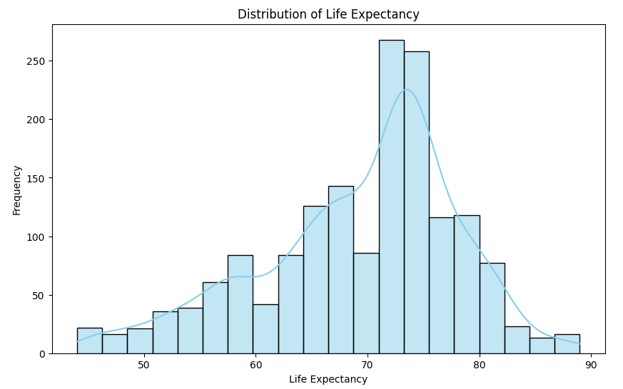
After Cleaning Datasets Using Python And Visualizing Using Matplotlib: Exploring Global Health Data
Explanation:
Data Cleaning: Removes extra spaces from column names for consistency.
Summary Statistics: Computes key statistics for numeric columns.
Visualization: Displays the distribution of life expectancy using a histogram.
Story:
In a health research project, data cleaning ensures consistency in column names, aiding smooth analysis.
Summary statistics reveal crucial insights into life expectancy trends worldwide.
Visualizing life expectancy distributions highlights variations, guiding targeted interventions for global health improvement.

Slide 17
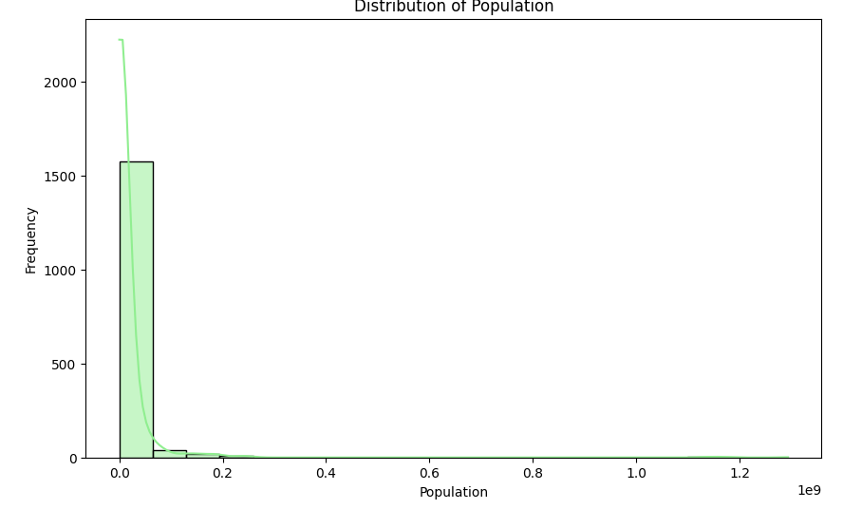
Understanding Global Population Dynamics: Distribution Analysis
Explanation:
Data Preparation: Ensures consistency in column names for clarity.
Statistical Insight: Reveals key population statistics for analysis.
Visual Representation: Depicts population distribution via histogram and KDE.
Story:
In a demographic study, data is prepared by standardizing column names to streamline analysis. Statistical examination unveils crucial population trends, essential for informed decision-making. Visualizing population distributions illuminates demographic disparities, guiding policy interventions for sustainable development.

Slide 18
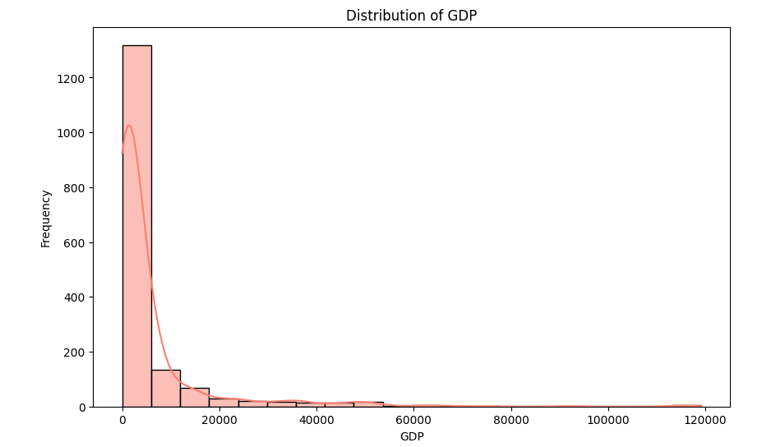
Exploring Global Economic Patterns: Distribution of GDP
Explanation:
Data Preparation: Cleans column names, ensuring uniformity.
Statistical Analysis: Computes summary statistics for GDP.
Visualization: Displays GDP distribution via a histogram with KDE.
Story:
In an economic analysis endeavor, data is prepped by standardizing column names for clarity. Statistical analysis uncovers insights into global GDP trends, vital for economic policy formulation. Visualizing GDP distributions highlights disparities, informing strategies for balanced economic development.

Slide 19
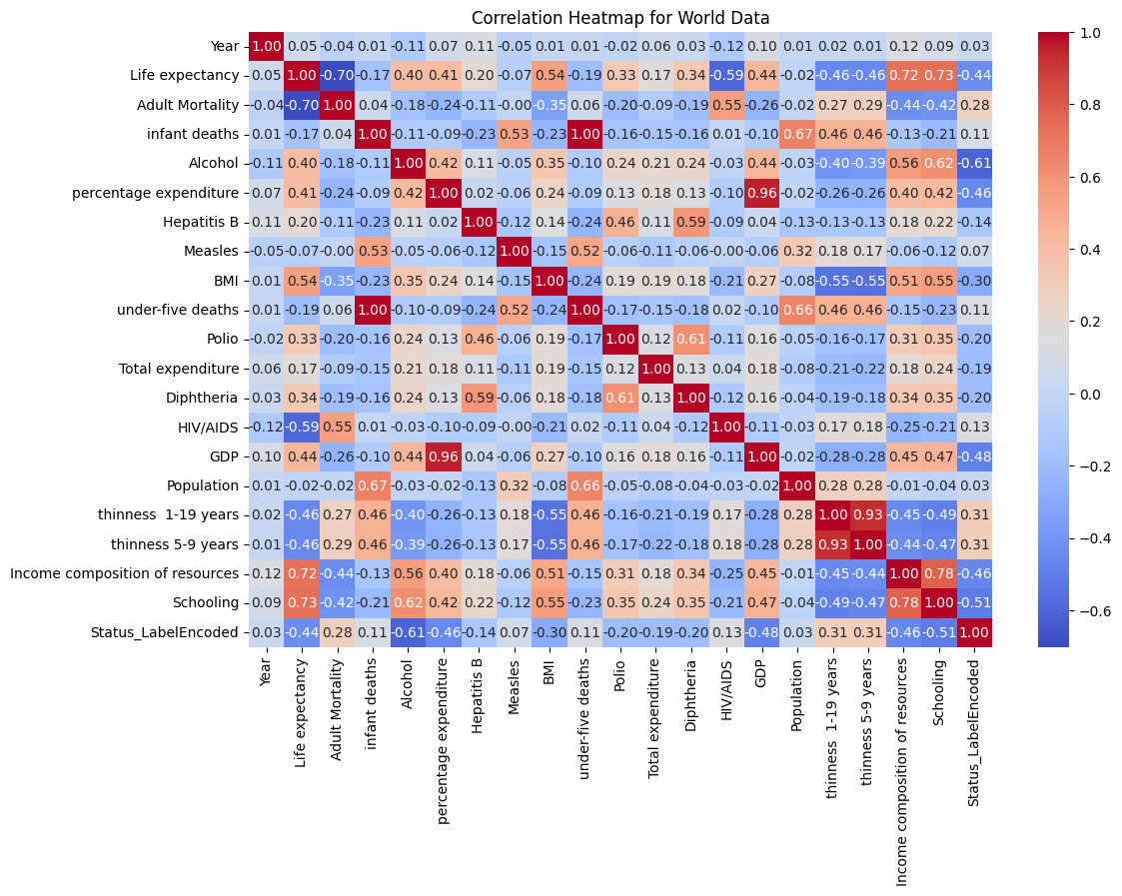
Analyzing Numeric Relationships: Correlation Heatmap
Explanation:
Data Filtering: Retains only numeric columns for correlation analysis.
Exploratory Analysis: Examines correlations between numeric variables.
Visual Insight: Presents correlations via heatmap with annotations.
Story:
In a data exploration endeavor, non-numeric columns are filtered out to focus on quantitative relationships.
Through exploratory analysis, correlations among numeric variables are investigated, offering insights into interdependencies.
Visualizing correlations via a heatmap aids in identifying patterns and guiding further analysis for informed decision-making.

Slide 20
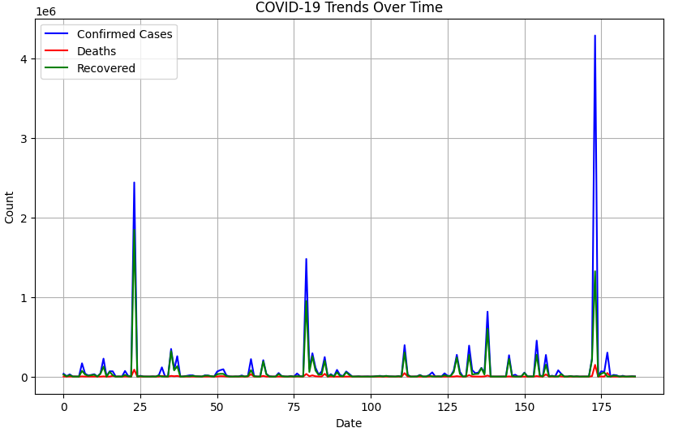
Analyzing COVID-19 Trends: Summary Statistics and Time Series Plot
Explanation:
Statistical Overview: Generates summary statistics for COVID-19 data.
Temporal Analysis: Plots trends of confirmed cases, deaths, and recoveries over time.
Story:
In assessing the COVID-19 pandemic, summary statistics offer insights into the overall magnitude and variability of cases.
Meanwhile, the time series plot depicts the progression of confirmed cases, deaths, and recoveries over time, enabling the observation of trends and fluctuations.
Through these analyses, policymakers and health authorities can better understand the impact of the pandemic and formulate effective response strategies.

Slide 21
Visualizing COVID-19 Metrics on a World Map
Explanation:
Data Loading: Imports the world map shapefile and COVID-19 data.
Data Merging: Merges COVID-19 data with world map data based on country names.
Map Visualization: Plots COVID-19 metrics (confirmed cases, deaths, recoveries) on the world map.
Story:
In mapping the global impact of COVID-19, the world map shapefile is loaded alongside COVID-19 data.
By merging these datasets, a comprehensive view of the pandemic's spread is achieved, allowing for spatial analysis.
The resulting visualizations depict the distribution of confirmed cases, deaths, and recoveries across countries, aiding in understanding regional variations and informing targeted response efforts.

Slide 22
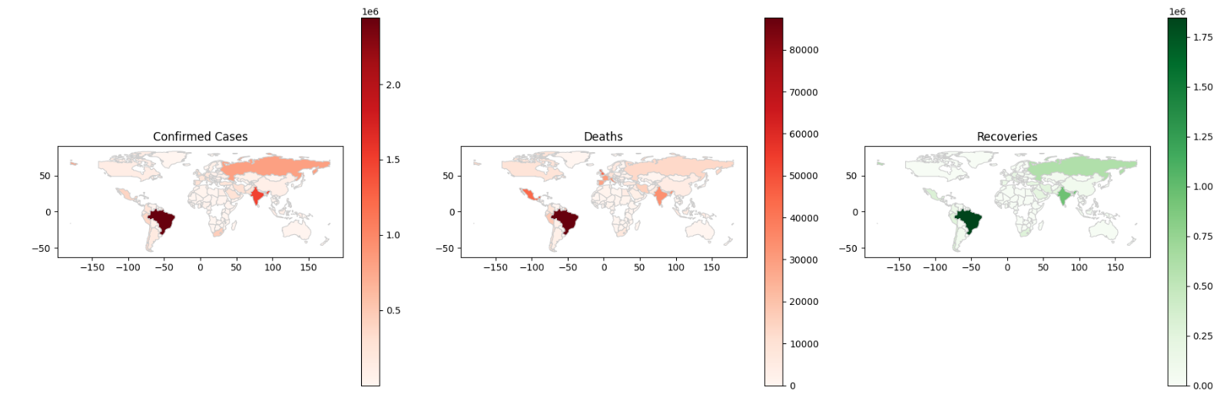

Slide 23
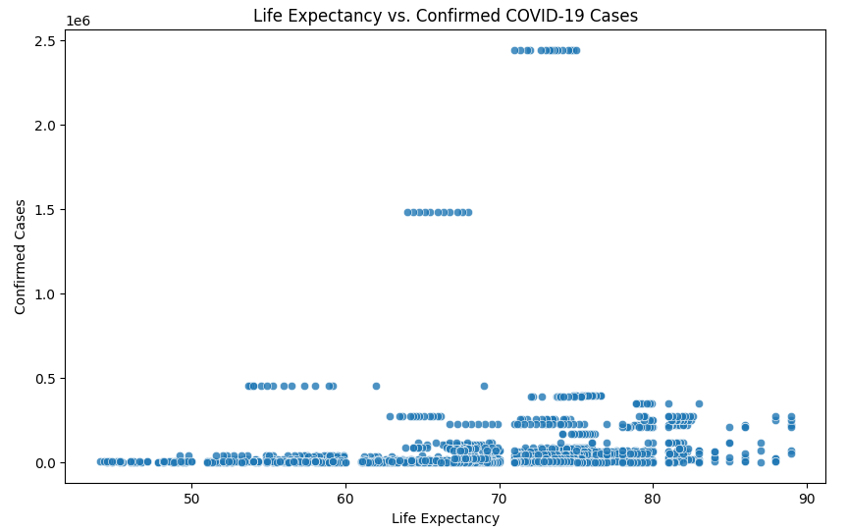
Exploring the Relationship Between Life Expectancy and COVID-19 Cases
Explanation:
Data Merging: Merges datasets based on the 'Country/Region' column.
Scatter Plot: Visualizes the relationship between life expectancy and confirmed COVID-19 cases.
Story:
By merging datasets on country/region identifiers, a comprehensive dataset is created for analysis.
Through a scatter plot, the correlation between life expectancy and confirmed COVID-19 cases is explored, offering insights into potential health disparities and vulnerabilities.
This analysis contributes to understanding how demographic factors may influence the spread and impact of the pandemic.

Slide 24
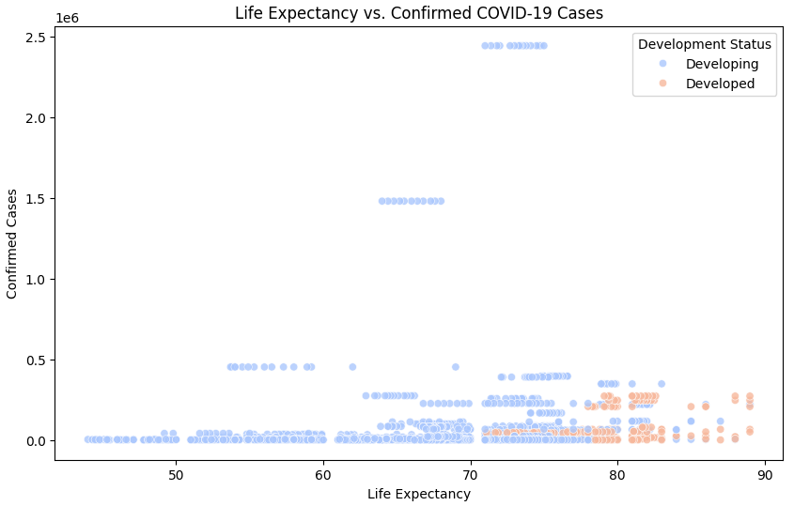
Examining Life Expectancy and COVID-19 Cases Across Development Status
Explanation:
Data Visualization: Displays a scatter plot of life expectancy against confirmed COVID-19 cases.
Color Representation: Categorizes data points by development status, enhancing visual interpretation.
Story:
In this scatter plot analysis, life expectancy is juxtaposed against confirmed COVID-19 cases, with data points color-coded according to development status.
The visualization facilitates the identification of potential correlations between socioeconomic factors and pandemic outcomes.
By examining disparities across development statuses, policymakers can tailor interventions to address health inequities and mitigate the impact of the pandemic on vulnerable populations.

Slide 25
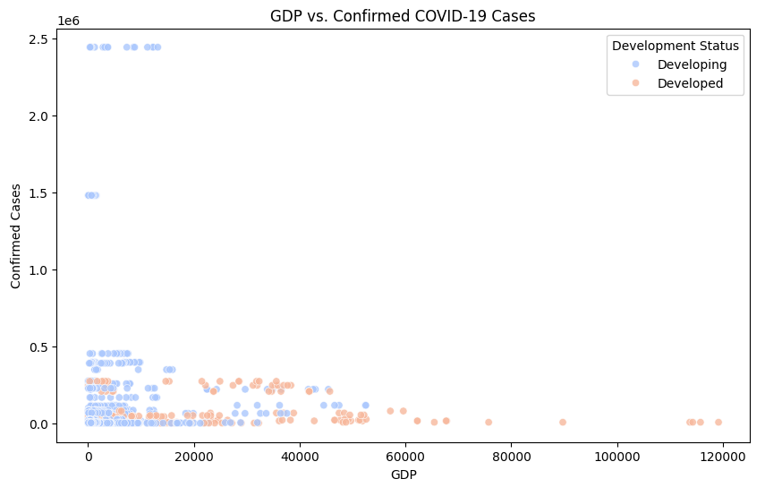
Exploring GDP and COVID-19 Cases Across Development Status
Explanation:
Visualization: Presents a scatter plot of GDP against confirmed COVID-19 cases.
Color Coding: Categorizes data points by development status for enhanced insight.
Story:
This scatter plot delves into the relationship between GDP and confirmed COVID-19 cases, with data points color-coded based on development status.
By examining how economic factors intersect with pandemic outcomes, stakeholders can better understand the socioeconomic dimensions of the crisis.
This analysis aids in identifying disparities in vulnerability and resilience across different economic strata, guiding targeted interventions for pandemic response and recovery.

Slide 26
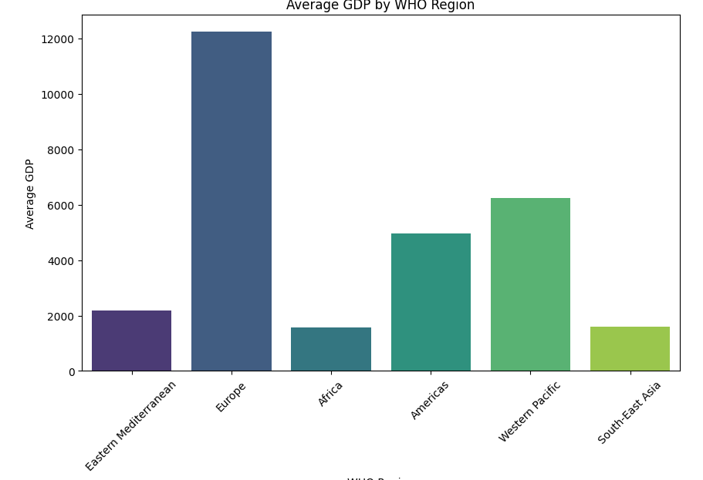
Comparing Average GDP Across WHO Regions
Explanation:
Visualization: Presents a bar plot of average GDP by WHO region.
Data Aggregation: Computes the mean GDP for each WHO region for comparison.
Story:
This bar plot showcases the average GDP across different WHO regions, providing insights into regional economic disparities.
By aggregating GDP data, the plot highlights variations in economic development among WHO regions.
Stakeholders can use this analysis to prioritize resource allocation and development initiatives, aiming to address economic inequalities and promote sustainable growth globally.

Slide 27
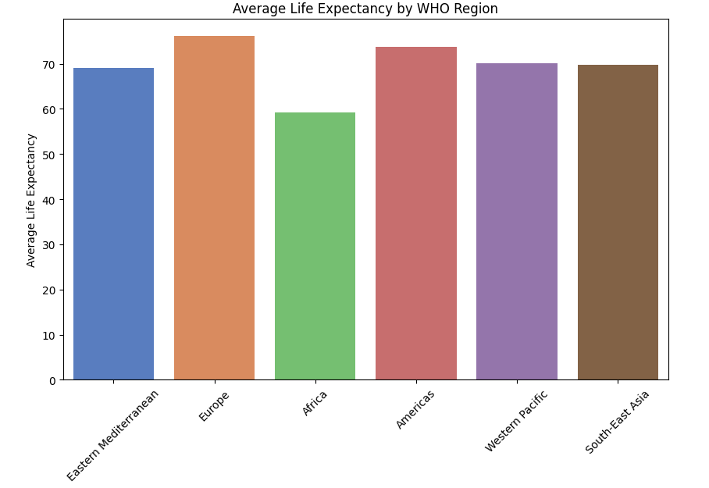
Comparing Average Life Expectancy Across WHO Regions
Explanation:
Visualization: Displays a bar plot of average life expectancy by WHO region.
Statistical Summary: Calculates the mean life expectancy for each WHO region for comparison.
Story:
This bar plot illustrates the average life expectancy across various WHO regions, shedding light on regional health disparities.
By analyzing average life expectancy data, stakeholders can identify regions with lower life expectancies and prioritize health interventions accordingly.
This analysis aids in understanding global health outcomes and guiding efforts to improve population health and well-being across different regions.

Slide 28
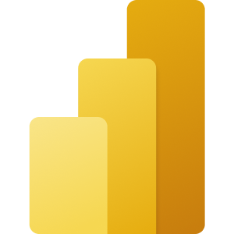
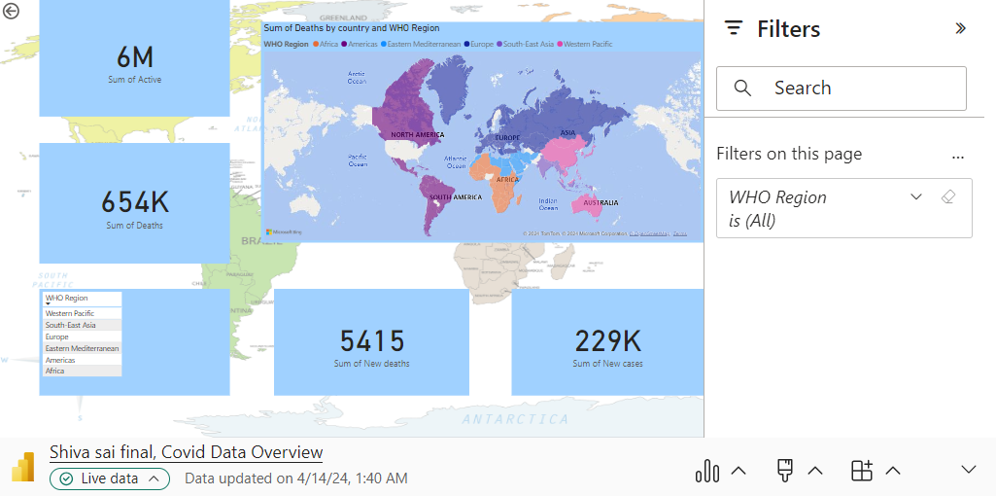
Microsoft Power BI

Slide 29
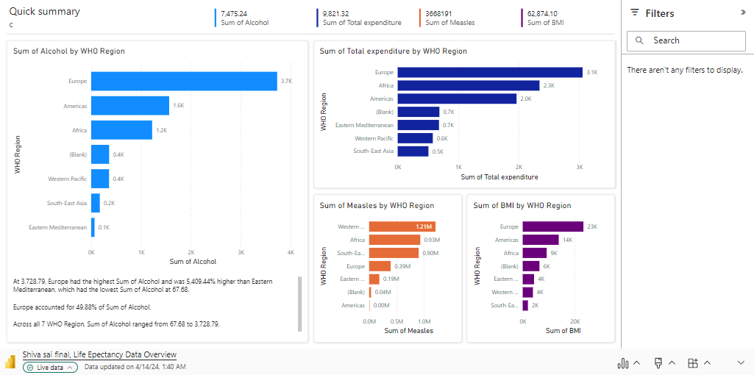
Microsoft Power BI

Slide 30
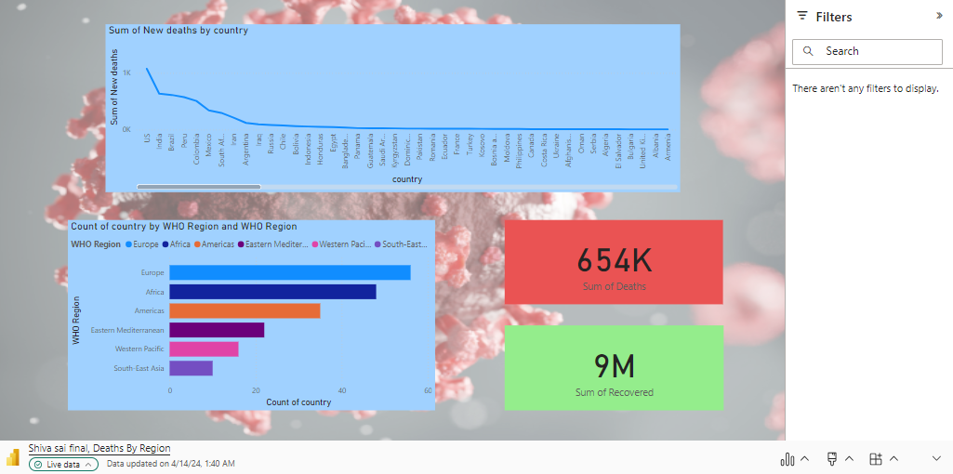
Microsoft Power BI

Slide 31
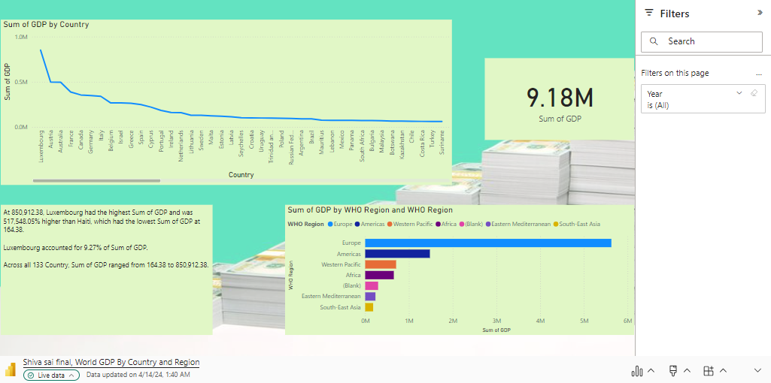
Microsoft Power BI

Slide 32
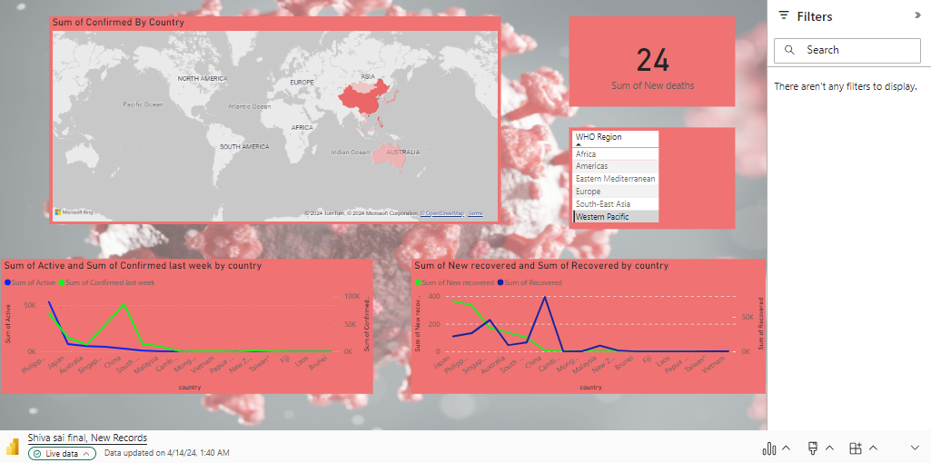
Microsoft Power BI

Slide 33
Work Management
Work Completed:
Data Acquisition and Cleaning:
Description: Obtained COVID-19, global population, and economic datasets. Cleaned data to ensure consistency and accuracy.
Responsibility: All team members.
Contributions: 100% by each member.
Initial Visualization Using D3.js:
Description: Created a pie chart of COVID-19 cases by WHO region using D3.js.
Responsibility: Siddhartha Alwala, Shiva Sai Kumar Tummala.
Contributions: 50% each.
Stacked Bar Chart of COVID-19 Cases:
Description: Developed a stacked bar chart showing COVID-19 cases by country using D3.js.
Responsibility: Vishnu Priya Palagiri, Bhargavi Kondaveeti.
Contributions: 50% each.

Slide 34
Cleaning Datasets Using Python and Visualization with Matplotlib:
Description: Cleaned datasets using Python. Visualized global health data with Matplotlib.
Responsibility: All team members.
Contributions: 100% by each member.
Exploring Global Population Dynamics:
Description: Analyzed population distributions and trends.
Responsibility: Siddhartha Alwala, Shiva Sai Kumar Tummala.
Contributions: 50% each.
Exploring Global Economic Patterns:
Description: Examined GDP distributions and correlations with COVID-19 cases.
Responsibility: Vishnu Priya Palagiri, Bhargavi Kondaveeti.
Contributions: 50% each.
Understanding Numeric Relationships:
Description: Investigated correlations between variables using a heatmap.
Responsibility: All team members.
Contributions: 100% by each member.

Slide 35
Analyzing COVID-19 Trends:
Description: Generated summary statistics and time series plots for COVID-19 data.
Responsibility: All team members.
Contributions: 100% by each member.
Visualizing COVID-19 Metrics on a World Map:
Description: Plotted COVID-19 metrics on a world map.
Responsibility: Siddhartha Alwala, Shiva Sai Kumar Tummala.
Contributions: 50% each.
Exploring Relationships Between Life Expectancy and COVID-19:
Description: Investigated the relationship between life expectancy and COVID-19 cases.
Responsibility: Vishnu Priya Palagiri, Bhargavi Kondaveeti.
Contributions: 50% each.
Overall Contributions:
Siddhartha Alwala -25% , Shiva Sai Kumar Tummala -25% , Vishnu Priya Palagiri -25% , Bhargavi Kondaveeti -25%

Slide 36
References:
World Health Organization. (2022). COVID-19 Dashboard. [Online]. Available: https://www.who.int/emergencies/disease-outbreak-news/item/2020-DON233. [Accessed: April 16, 2024].
D3.js Documentation: https://d3js.org/
Matplotlib Documentation: https://matplotlib.org/stable/contents.html
Pandas Documentation: https://pandas.pydata.org/docs/

Slide 37
Links:
https://vizhub.com/bhargavikondaveeti/c273a818d4d04170b1a620d29f5a6bbe
https://vizhub.com/bhargavikondaveeti/c273a818d4d04170b1a620d29f5a6bbe?mode=embed
https://gist.githubusercontent.com/bhargavikondaveeti/209440046523e6eec9b6d4efc334f60f/raw/2d1ed33decd151c0aa10584d6e570f8175c5f0b0/project_covid_data.csv
https://gist.githubusercontent.com/bhargavikondaveeti/44c211fa68660eaa099633f5a716129b/raw/030d27261f13125b7c81aed94f2ae6c0f6ab3dd2/life_expectancy_verma.csv
Project Final Video.mp4
https://siddharthaalwala.github.io/CSCE_5320_Final_project/

